Slide 1

Introduction to Financial Domain
01/08/2016
The information contained in the document is proprietary to Tata Industries Limited- Tata Insights & Quants Division and is strictly confidential. In consideration of receipt of this document, the recipient agrees that the information is being shared only for the limited purpose. The recipient of this information further agrees to maintain such information in confidence and to not reproduce, disclose, duplicate, electronically transmit or use in whole or in part for any other purpose. Prior written consent shall be obtained from the Insights & Quants Division of Tata Industries in case the information is necessitated to be shared with anyone other than the Recipient to whom this information is addressed. The above restriction shall not limit the right to use the information contained in this deck, if it is obtained from another source without restriction.
© Copyright, Tata Insights & Quants Division, Tata Industries Limited

Slide 2

Introduction to
Exchange System

Slide 3
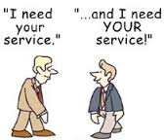
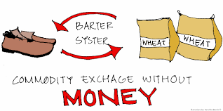
Earliest Form of Exchange: Barter System
Barter system is the oldest method of exchange, used for centuries and long before money was invented where people exchanged services and goods for other services and goods in return.
Inconvenience of Barter System
1. Exchange of goods can take place between two people if each possess
the good other person wants
2. If incidentally two person met together who wants each other’s goods
they cannot find a satisfactory value of their goods
3. Goods cannot be stored for a long time because their value declines as
time passes

Slide 4
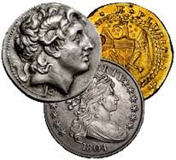
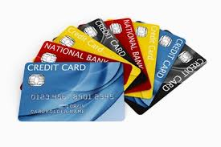


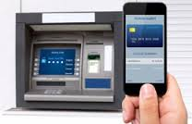
Evolution Of Money
Money is the current method of exchange, in the form of coins and banknotes paid either physically
or electronically
Metallic
Money
Credit
Money
Paper
Money
Commodity Money
Electronic
Money
Earliest form of money
Minted and used for exchange. Typically made of expensive metals like gold , silver etc
Money issued against cheques, treasury bills, bonds and recently credit cards
Most popular form of money
The Barter system for exchange
Transfer across accounts or institutions without human interference

Slide 5
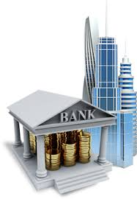
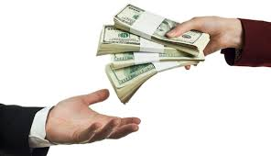

How money exchange happens: Parties involved
Money is the current method of exchange, in the form of coins and banknotes paid either physically
or electronically
A
Financial
Borrower
C
Financial Institutions/Intermediaries
B
Financial
Lenders
A person or entity that obtains funds from a business or individual for a specified period of time upon condition of promising to repay the loan.
Borrowers can be individuals, companies, state/central governments , municipalities, public corporations etc
A person or entity which has excessive funds who are ready to lend their money for a specified period upon condition of repaying interest
Borrowers can be individuals, companies, state/central governments , municipalities, public corporations etc
Financial institutions aacts as facilitators between borrowers and lenders
They act as mobilisers and depositors of savings

Slide 6

Financial Institutions

Slide 7



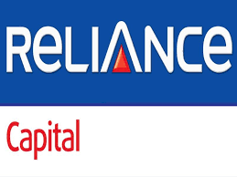


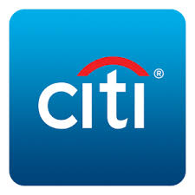




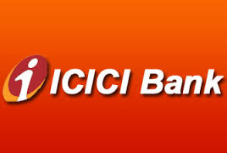



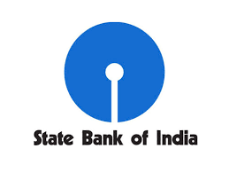
Types of financial institutions
Financial Institutions
Banking
Institutions
Non-Banking
Institutions
Insurance Institutions
Retail/Commercial Banking
Investment
Bank

Slide 8
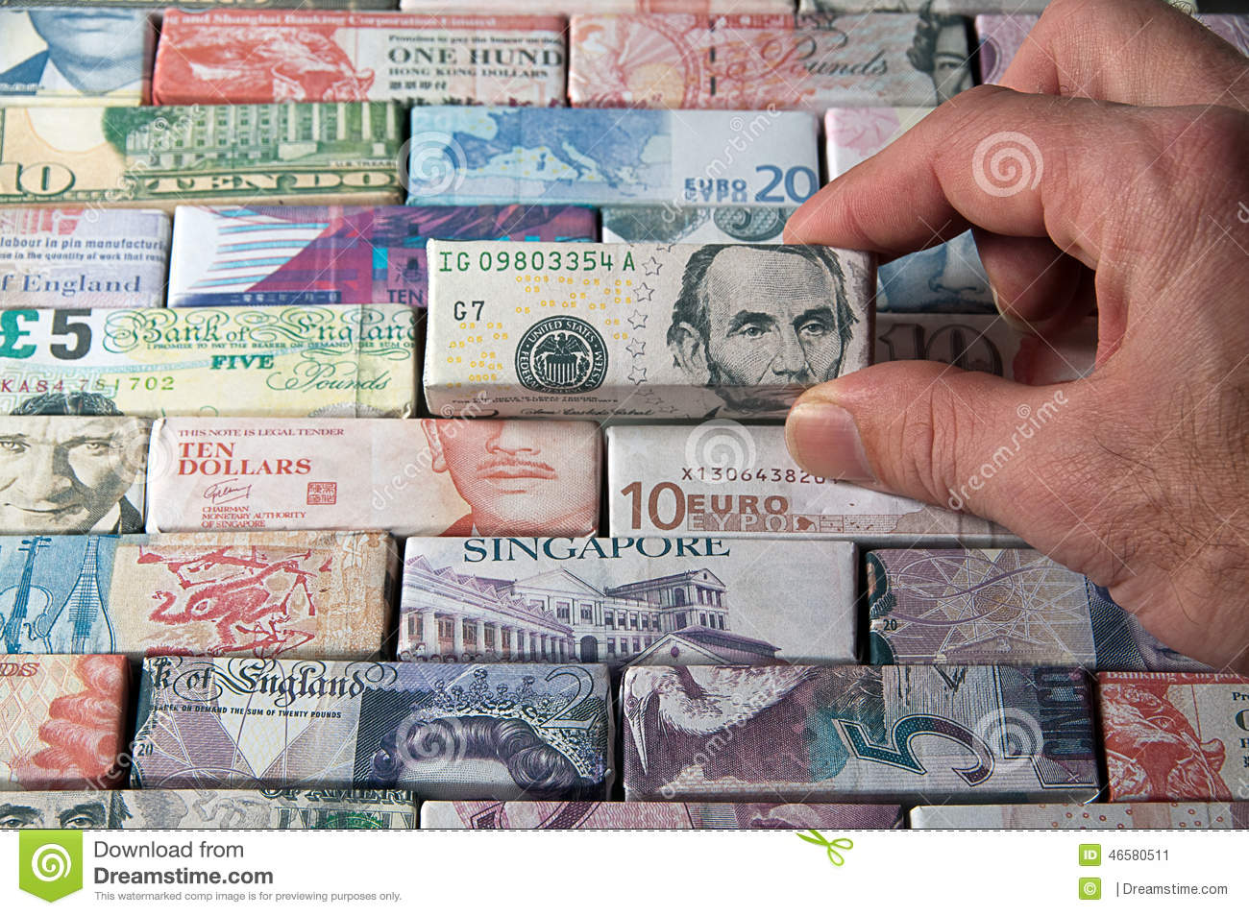
Banking

Slide 9



What is a bank
Financial Institutions
Bank is an establishment authorised by a government to accept deposits, pay interest, provide loans, act as intermediary in financial transactions and provide multiple financial services to customers
A Retail/commercial bank is a financial institution that provides services, such as accepting deposits, giving business loans and auto loans, mortgage lending, and basic investment products like savings accounts and certificates of deposit.
An Investment bank Investment banking is a specific division of banking related to the creation of capital for other companies, governments and other entities. Investment banks underwrite new debt and equity securities for all types of corporations aid in the sale of securities and help to facilitate mergers and acquisition

Slide 10
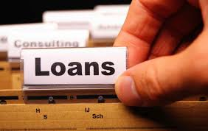



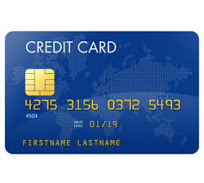

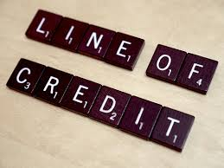
Banking Operating Model
ASSETS
(Assets portion of a bank's capital includes cash, government securities and interest-earning loans, such as mortgages, letters of credit and inter-bank loans)
INSURANCE
(An arrangement by which a company or the state undertakes to provide a guarantee of compensation for specified loss in return for payment of a specified premium)
)
LIABILITIES
(Liabilities section of a bank's capital includes loan-loss reserves and any debt it owes, and all deposits/savings on which it ha to pay out interest to customer)
Net Interest Income
Net Fee Income
Net Feet Income
Commission Rate
Net Interest Income
ALCO
(Facilitates management of the interest
rates for borrowing/lending within banks)
Net Fee Income
Commission Rate
INVESTMENT
(An investment is an asset or item that is purchased with the hope that it will generate income or appreciate in the future)

Slide 11

Banking Asset Products

Slide 12

Loan Against Property
Financial Institutions
A home equity loan is a type of loan in which the borrower uses the equity of home as collateral. The loan amount is determined by the value of the property, and the value of the property is determined by an appraiser from the lending institution
Fixed Rate Loan
Flexible Rate Loan
Loan on property
at a fixed rate for the
entire tenure
Loan repayment
instalment
independent of market
conditions
Loan on property
at a flexible rate for the
entire tenure
Loan repayment
instalment can go up or
down based on market
conditions
Home Loan is always given upto 80% of the Loan to Value of the property

Slide 13




Loans
Loan is something that is borrowed, especially a sum of money that is expected to be paid back with interest. Banks makes money out of the interest levied and fees like processing fee, late fees etc.
Financial Institutions
Personal Loan
Overdraft
Auto Loans
Consumer Durable Loan
Loan against no collateral. Fixed payments on a monthly basis throughout tenure
Unsecured lending
Loan closure possible only after 6 months.
Loan closure fees levied on customer
Highest interest rate within loan products
Loan against no collateral associated with savings account
Fixed payments on a monthly basis throughout tenure
Unsecured lending
Loan closure fees levied on customer
Loan against car. Fixed payments on a monthly basis throughout tenure
Secured lending
Loan closure fees levied on customer
Loan against consumer durables. Fixed payments on a monthly basis throughout tenure
Secured lending
No loan closure fees levied on customer

Slide 14



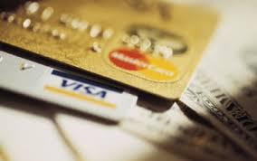



Credit Cards
Financial Institutions
A credit card is a payment card issued to users as a method of payment which allows the cardholder to pay for goods and services based on the holder's promise to pay for them.
Credit Cards…….Some commonly used terms
APR
Credit Limit
Outstanding Balance
Annual Fees
Annualised interest rate
charged on the outstanding balance
Total amount you can spend
on your card
Total amount that you have
Spend on your card which you
Have to pay back
Total fees you need to pay annually/one time for card maintenance
Late Fees
Trans-actors/Defaulters/Revolvers
Credit Cycle
Transactors: Customers who pay the entire outstanding balance every time
Revolvers: Customer who pay part of the outstanding balance every time
Defaulters: Customers who does not pay anything of the outstanding balance
The days within which you
Have to pay back the amount
spend on card. Its usually
45 days
If you do not pay the credit
Card bill on time, the fees
levied for late payment

Slide 15

Banking Investment Products

Slide 16

Mutual Funds
Financial Institutions
Mutual Funds is a professionally managed investment scheme that pools money from many investors to buy stocks,
bonds and other securities
Mutual Funds Life-Cycle
Mutual Funds Categories
Investors pull in money
Fund Managers decide on securities to invest
Fund manager generates returns and paases it back to investors
Maturity Period
Investment Type
Open Ended: (Subscription and purchase on continuous basis with no fixed maturity period)
Equity
Capital appreciation, highly risky
Income
Regular and steady income, less risky
Balanced
Both in equities and income funds
Close Ended: (Subscription and purchase not on continuous basis with fixed maturity period)
Money Market
Investments in government securities
Index
Rise and fall in accordance with market index

Slide 17

Banking Liability Products

Slide 18



Deposit Products
Financial Institutions
Savings
Current
Fixed Deposits
Banking product where you keep money with a guaranteed interest
Liquidate anytime
Can be accessed through internet, debit cards, ATM’s
Salary account is a type of savings account
Minimum quarterly balance to be maintained
Banking product where you keep money but receive no interest
Liquidate anytime
Can be accessed through internet, debit cards, ATM’s
Business account is a type of current account
No minimum balance to be maintained
Banking product where a certain amount of money is locked in for a certain tenure with guaranteed returns
Liquidated post completion of tenure

Slide 19

Banking Data

Slide 20


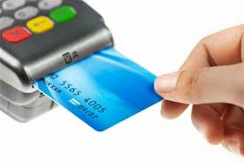
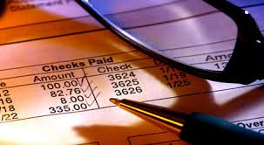

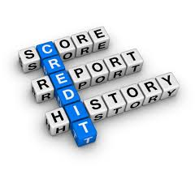


Banking Data Source
Financial Institutions
Customer
Transaction
Products
Account
Customer information and contacts
Daily data on customer transactions
Product holdings for customers
Account level information for customers
CRM
Credit Bureau
Funds
Digital/Social
Customer relationship management details
Customer’s historic credit data
Daily data on value of holdings
Data on digital effectiveness

Slide 21

Analytics Opportunity in Banking

Slide 22
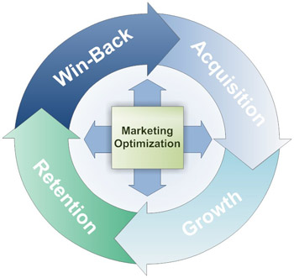

Customer Life-cycle & Analytics Application
Win-back
Acquisition
Win-back strategy
Win back offers/promotions
Prospecting
Offers/Promotion
On-boarding
Customer Experience Management
Retention
Growth
Proactive/Reactive Retention
Attrition/Churn Analysis
Preferential Pricing for retention
Top-up framework for non sticky products
Effective cross-sell/up-sell
Customer Life-stage based targeting
Next Best Product/Offer
Contact Strategy
Customer Channel preference
Sales Effectiveness
Customer Lifetime Value
Customer Sentiment Analysis

Slide 23

Insurance Industry

Slide 24

Insurance Institutions
Financial Institutions
Insurance is an arrangement by which a company or the state undertakes to provide a guarantee of compensation for specified loss, damage, illness, or death in return for payment of a specified premium.
Why do we need insurance?
1. Degree of uncertainty associated with any loss cannot be quantified
2. Accuracies in predicting uncertainty
3. Ensure your dependants are taken care of in your absence

Slide 25







Insurance: Basic Concepts
Financial Institutions
Insurer
Underwriting
Insured
IRDA
Person/company that underwrites an insurance risk; the party in an insurance contract undertaking to pay compensation
Insurance Regulatory and Development Authority of India, an agency of Government for insurance sector supervision & development.
Sign and accept liability under (an insurance policy), thus guaranteeing payment in case loss or damage occurs.
Person/organization covered by insurance
Sum Assured
Policy
Premium
Sum assured is the amount of money an insurance policy guarantees to pay up before any bonuses are added. In other words, sum assured is the guaranteed amount the policyholder will receive.
Premium is the amount of money that an individual/business must pay for an policy. The premium is considered income by the insurance company & also represents a liability that insurer must provide coverage for claims being made against the policy
Document detailing the terms and conditions of a contract of insurance.

Slide 26











Insurance: Different products available
Financial Institutions
Insurance
Life Insurance
General Insurance
Investment
Bank
Term
ULIP
Savings
Retirement
Child
Marine
Health
Fire
Auto
Travel

Slide 27
Insurance Life Cycle & Product Offerings
Financial Institutions
Convert Term to permanent coverage
Term Life Insurance
Retirement
Estate/Retirement Planning
Highest Income & Tax Savings
Grow Income/Family
Savings(
Charitable Involvement
Getting Married
Plan for retirement (Retirement)
Charitable Involvement
Increase cover age on Savings
Secure Child future (Child)
Start Career
Basic Family Protection (Term)
Quick Gains (ULIP)
Long Term Savings (Savings)
Basic Protection (Savings)
Quick Gains (ULIP)
25
35
45
55
65

Slide 28
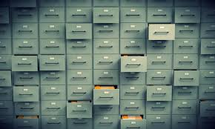
Insurance Data

Slide 29








Insurance Data Offerings
Financial Institutions
Existing customer base
1. Customer
2.
Policy
Customer Policy Information
7. Product
3.
Agent
Product related information
Data of all agents who facilitate insurance policy sell
4.
Claims
All data on customer relationship management, customer complaints
History of all claims on the policies and its resolution
6. CRM
5.
Payout
All payouts made by the
insurance company

Slide 30

Analytics Opportunity
in Insurance

Slide 31














Analytics Opportunity In Insurance
Increase Cross-Sell/Up-sell
Social media analysis
Digital Effectiveness
Life-stage based targeting
Retention & Renewals
Event Triggers
Customer Management
Claim
Management
Risk Management
Channel, Sales & Distribution Management
Sales -force management
Sales forecasting at city/region level
Lead Generation and optimization
Call centre management
Call centre optimization
Claims registration
Fraud detection
Claims estimation analysis
Medical Management
Claim payouts
Planning and budgeting
Compliance management
Reinsurance policy management
Underwriting policy management
Actuarial analysis

Slide 32
Thank You

